Slide 1
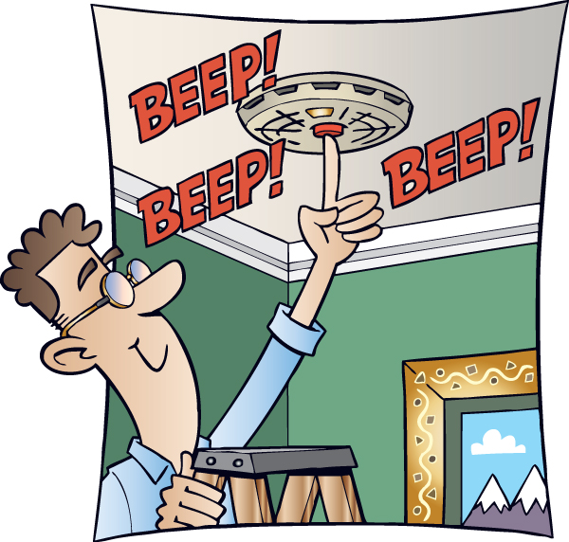
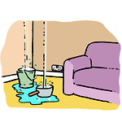
Environment And Scenario
1.Fire/CO detection
We might be so busy to in our daily works and forget about things that can burn down the whole hose and also can cause death. So with the smoke detection technology, we get alarmed as soon as any smoke or fire is detected. Thus we can take actions to stop it. there are several types of pollutants like carbon monoxide, dust, soot, pollen, temperature, humidity, air staleness, pollution, and particles that can threaten our home environment and air quality, all which could lead to property damage and harm to the people inside. Since CO is odorless and undetectable without assistance, a detector can be a life saver, especially when it is connected to an emergency monitoring service.
2. Leak/moisture detection
as long as homes have plumbing, water leaks have been a big problem for owners to deal with. It can destroy our house structure behind our back.So leak/moisture detection technology detects the leaky pipes, humidity, freezing and high temperatures in the installed area which could cause huge.
3. Window & door open and close
Windows and doors are the most vulnerable points of a house. Door and window sensors keeps us updated about the current movement of these points.It can control lights depending on the doors are opened or closed. It can detect damage and sends notifications in our phone wirelessly to prevent from being theft.

Slide 2
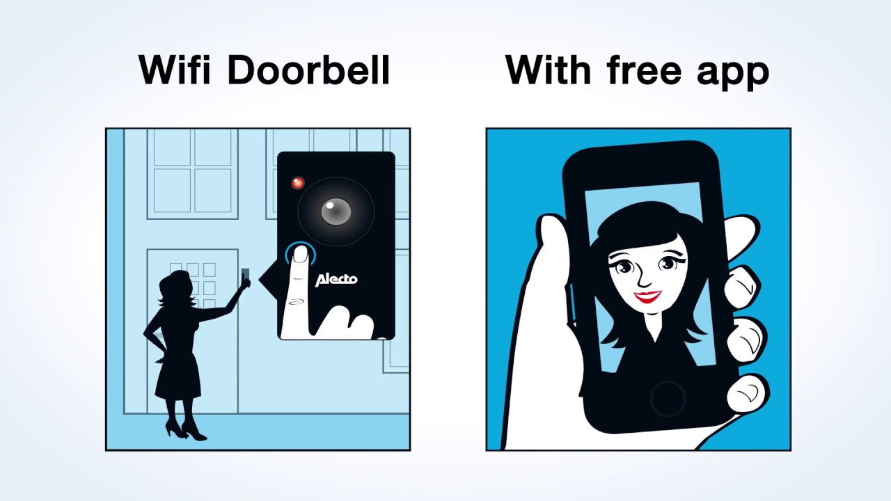
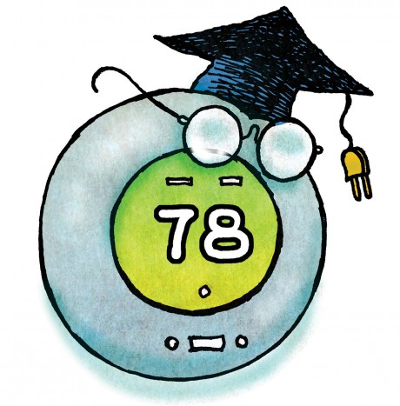

4. Video doorbell
It is the cool device that allows us to see who/what is infront of the door connecting wirelessly in our phone.Wheather we are at work or in home now we can observe the situation which can be connected with the door sensor.
5. Smart thermostat
Temperature control is one of the biggest feature of smart home. Our house needs to be cooled or heated according to our room temperature which is possible now using smart thermostat. It can monitor the house temperature and humidity inside and outside. It adjusts the temperature according to our existence in the house and usage of the room and maintains ideal temperature. It also uses power saving functions and user preferences.
6. Motion sensors
Motion sensor is like the extra pair of eyes for our house alerting such as anyone sneeking out or a child enters in a danger area of the house like kitchen, medicine cavinet.It guards our house by observing motion and movements and also informs if our doors or windows have been opened or closed. There are several types of motion sensors like Passive infrared(detects body heat), MiceoWave, Dual tech motion sensors, Area reflective, Ultrasonic.

Slide 3
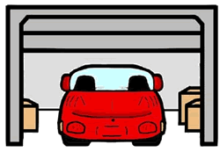

7.Smart garage door
Smart garage door sensors has amazing functionalities. It can open and close by detecting our vehicle appearances and also can be controlled by wi-fi through our phone.
8. Intercom/hub
If we have set all the necessary smart sensors we need a device to control all the sensors from one place. The hub and intercom allows us to modify all sensors and mains a communication system all over house. It can be set to call for for services, emergency or repairs if particular sensor updates about any damage. We can control our house staying away. It’s like communicating with the house and also can take necessary actions
10.Pest control
Bugs are one of the biggest enemies of our life.They are like all creatures, but nobody wants them in their home. Bug detection device detects the house bugs like dust mites, weevils, carpet beetles, centipedes, fruit flies, cockroaches etc. This sensor detects their thermal movements and finally recognizes the bug. Then it sends notification to the user and calls for pest control.

Slide 4
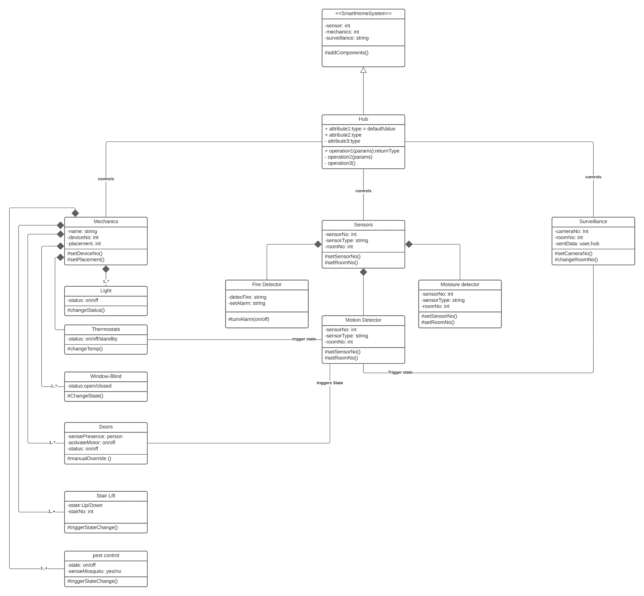
Class Diagram

Slide 5
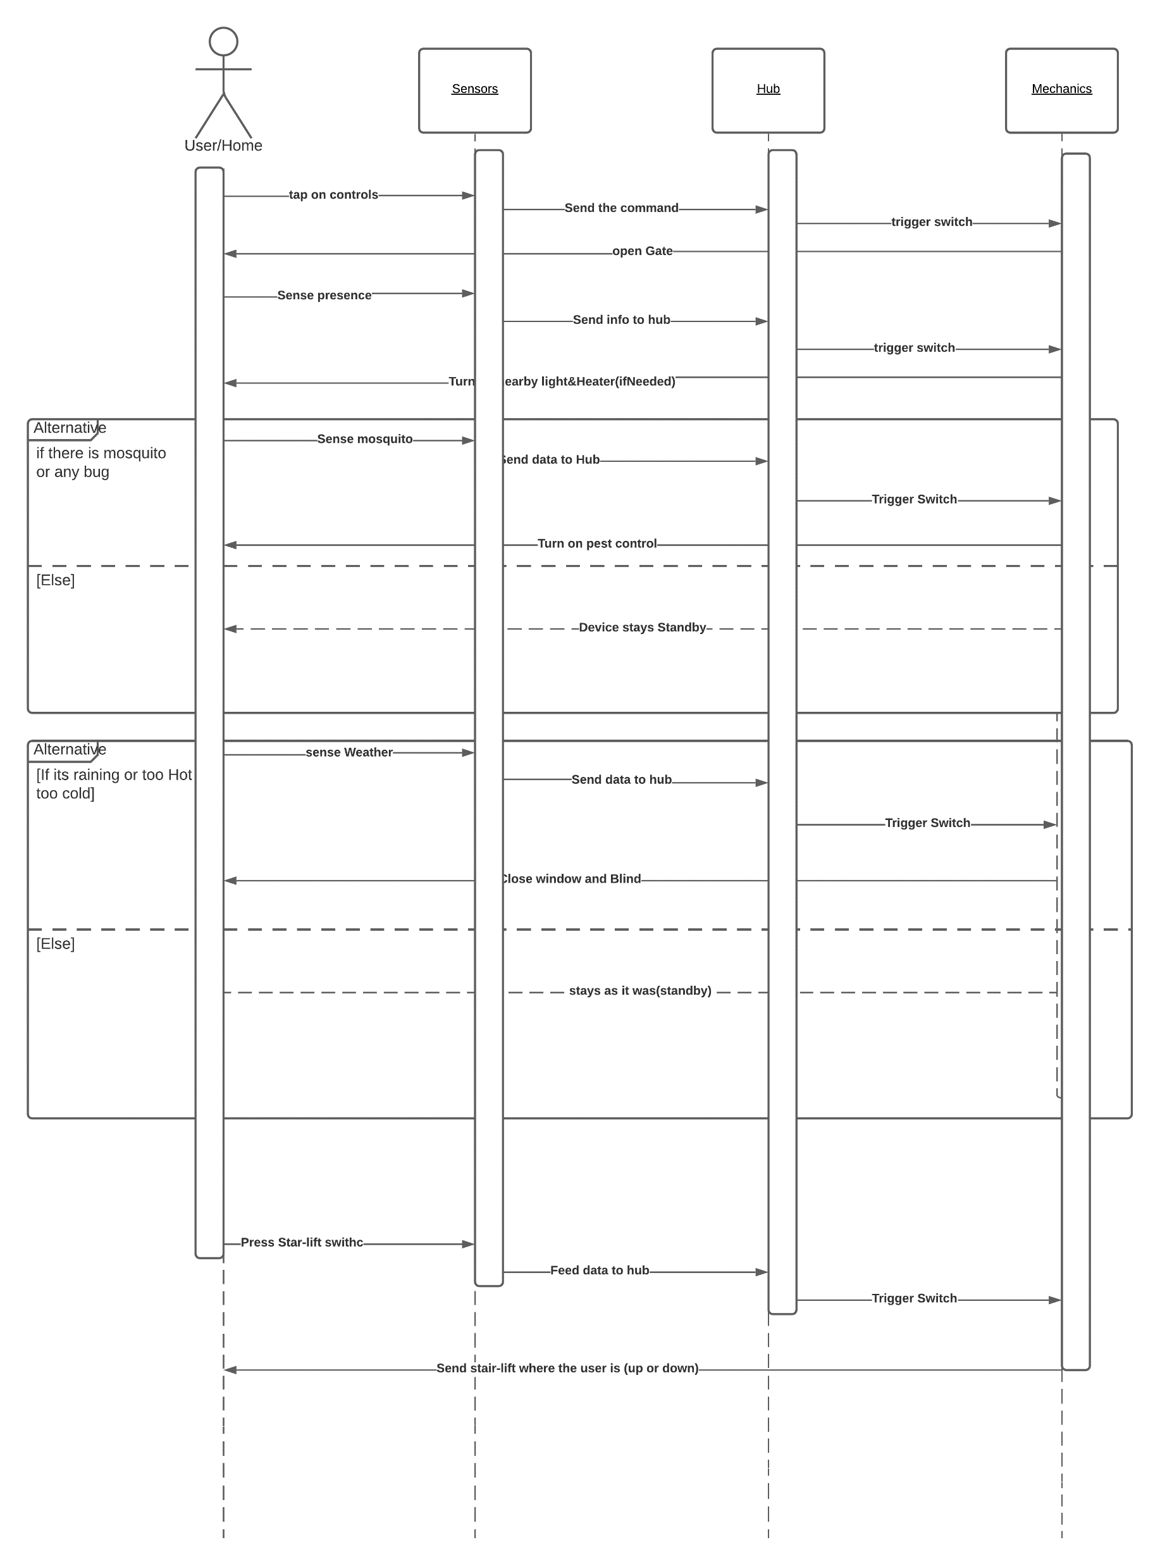
Sequence Diagram

Slide 6
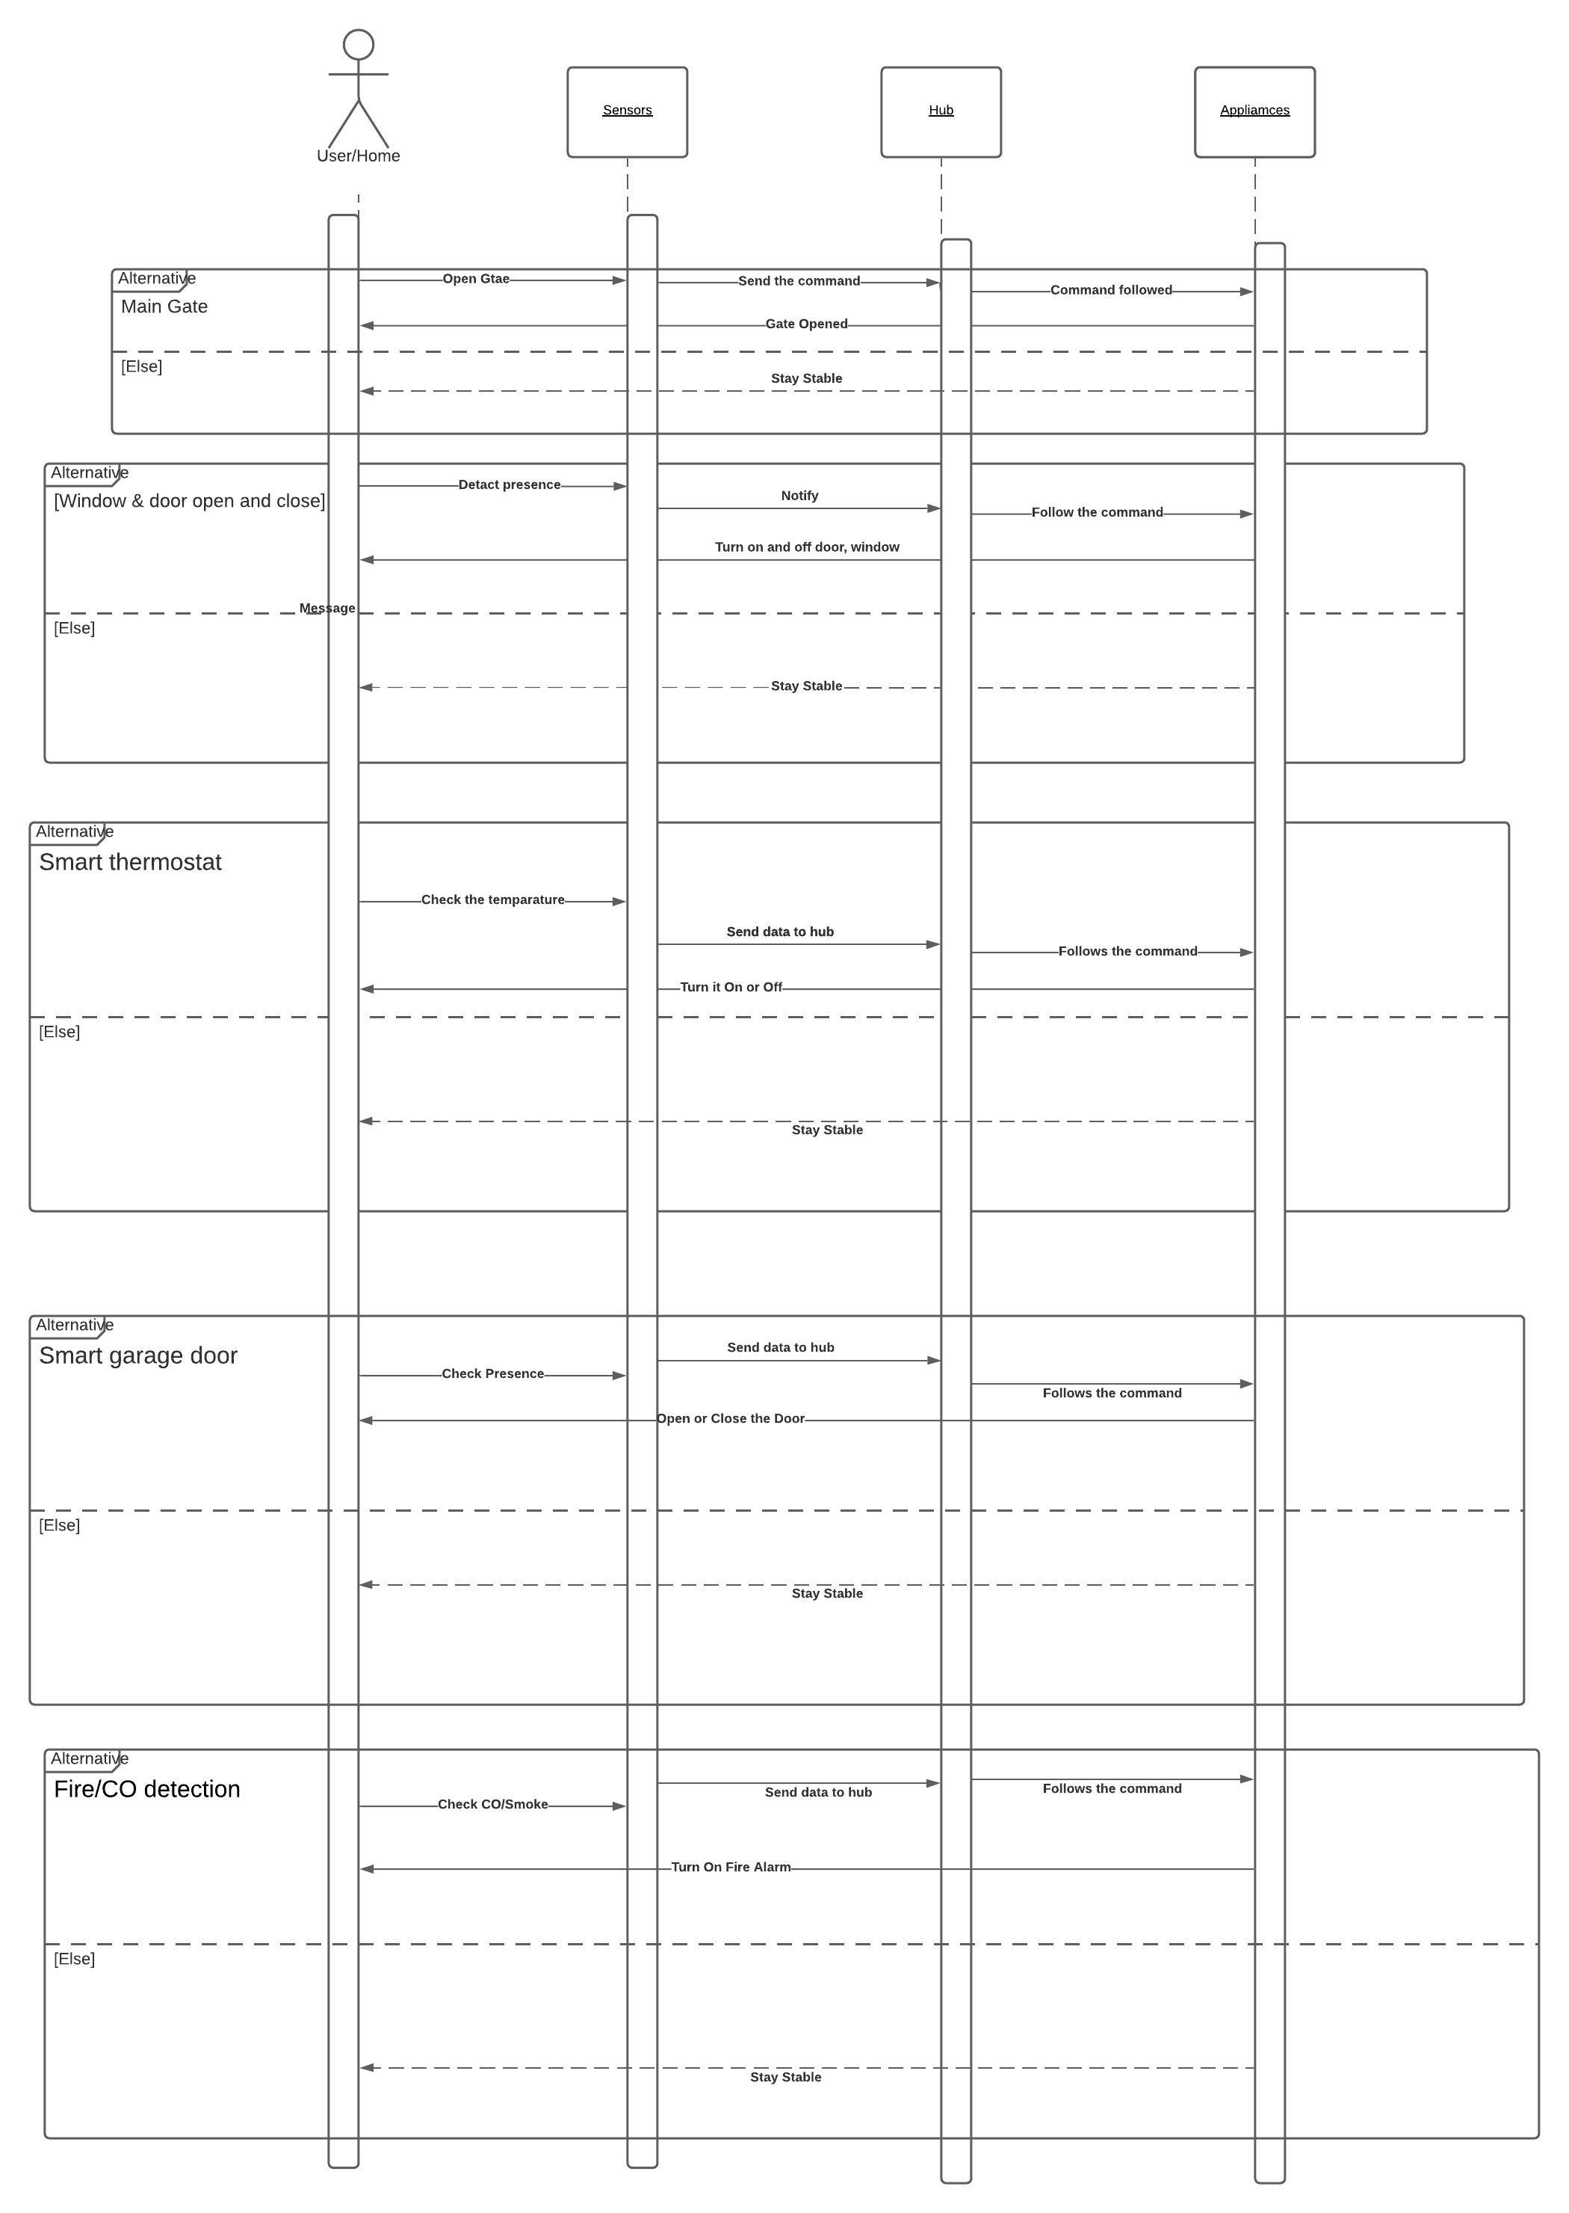
Sequence diagram
MD LIMON APU

Slide 7
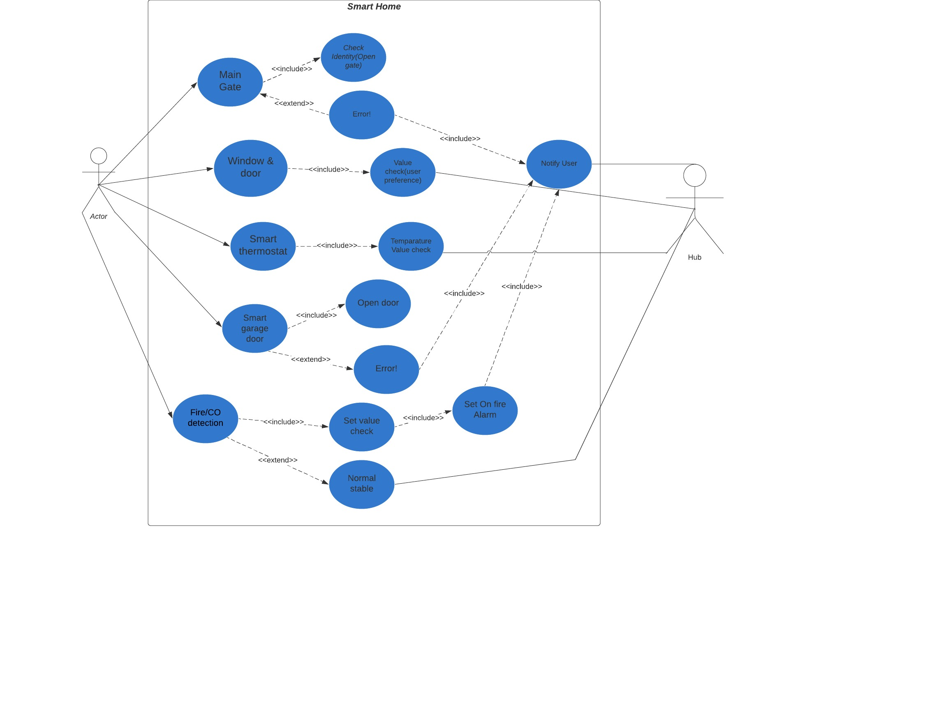
USE CASE DIAGRAM
MD LIMON APU

Slide 8
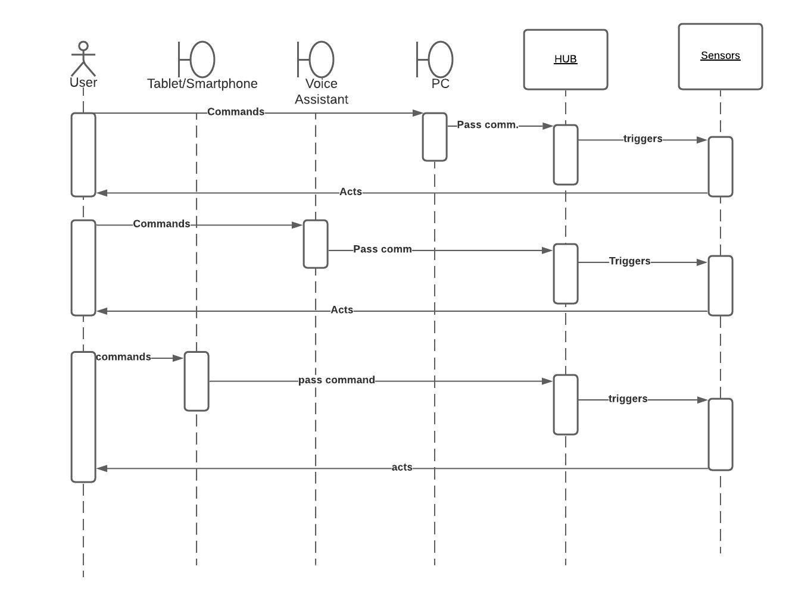
User Interaction Sequence Diagram
Arfat Kamal

Slide 9
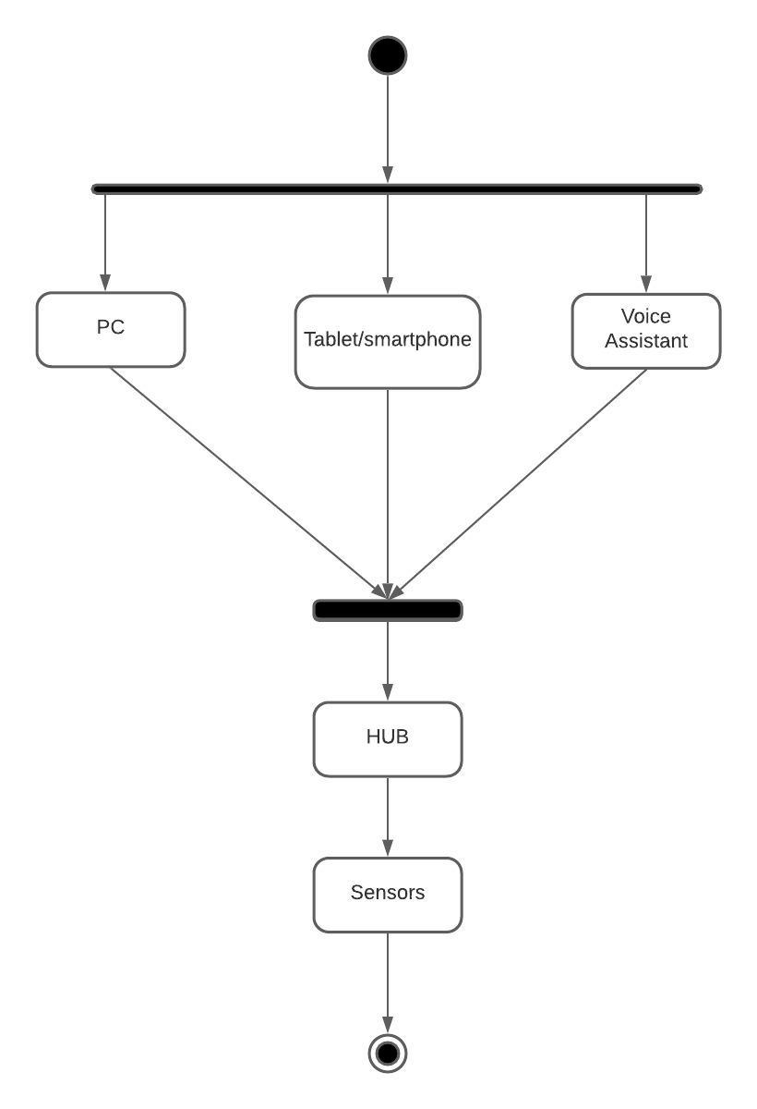
User Interaction Activity Diagram
Arfat Kamal

